Slide 1
DJ Simulator – Project Proposal
Student: Mac Baranowski
Project supervisor: Andreas Hoppe

Slide 2
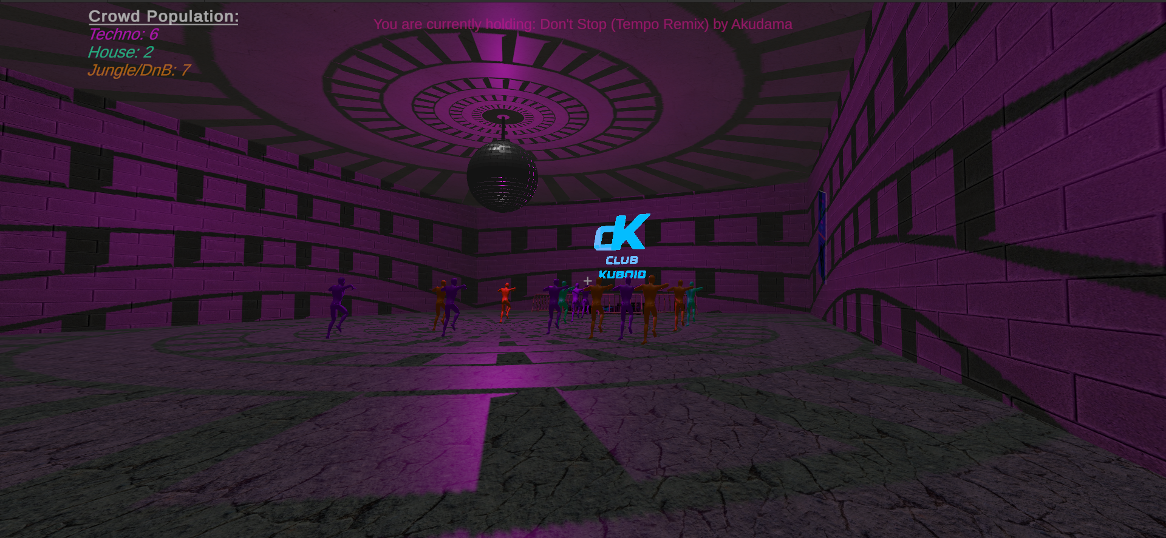
Game overview
You are a DJ that needs to make it big in the nightlife scene. To succeed, you must perform excellent DJ sets that score plenty of points. In order to gain points, you must ensure you are picking the right tracks for the crowd and that you are mixing the tracks smoothly. Can you become the best ranked DJ and climb the points ladder?

Slide 3
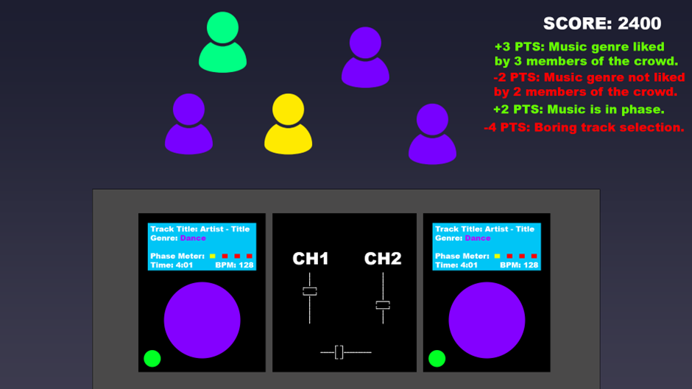
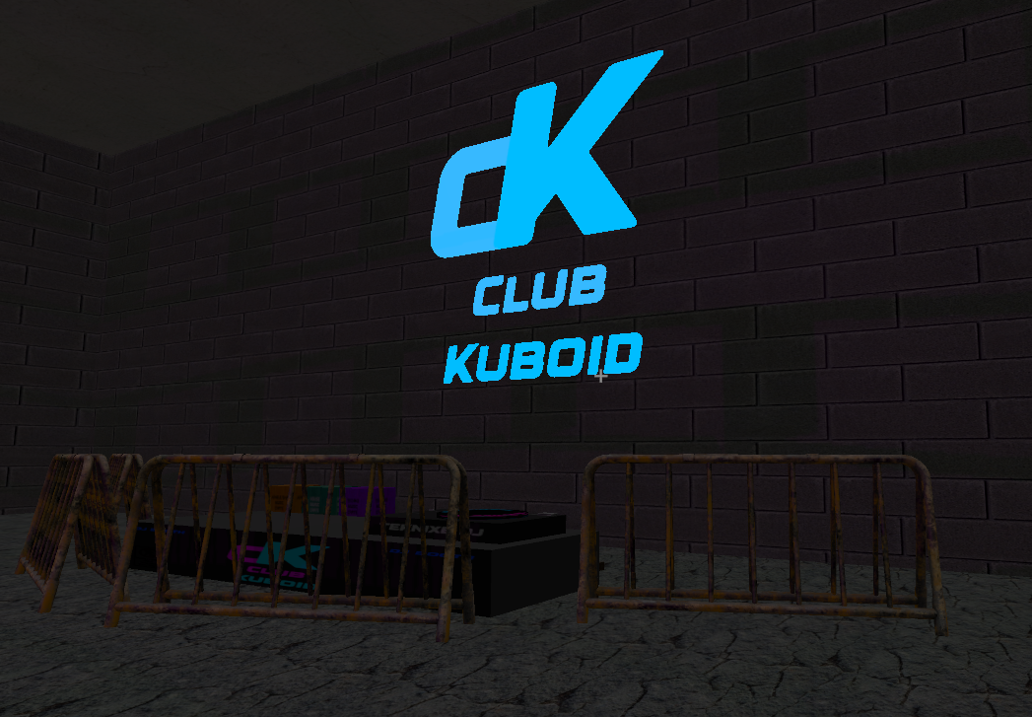
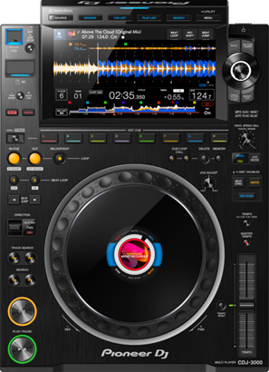
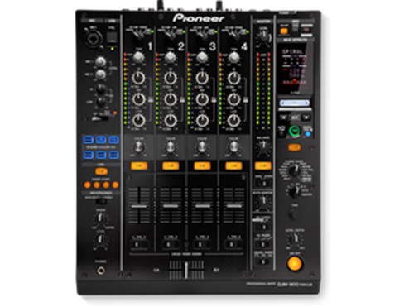
Game aesthetics
Fig. 1
Fig. 1: initial concept art for the game.
Fig. 2: screenshot from the in-engine prototype.
Fig. 3: image of club-standard equipment used by DJs.
Fig. 2
Fig. 3

Slide 4

Main game mechanic
Your view throughout the game will be of the DJ decks and of the crowd. The crowd will be colour coded based on the music that they like. The tracks that are being loaded onto the decks will also be colour coded based on their genre. The aim of the game is to score as many points as possible during a timed DJ set. There are multiple ways to gain (or lose) points.
Selecting tracks that appeal to the majority of the crowd will award points. As mentioned before, you must select genres of music that appeal to the crowd.
It is also important that the transitions between tracks are smooth and on beat. In the real world, Pioneer CDJ decks feature a phase meter, that shows the DJ if the two tracks currently playing are on beat or not. A similar system will be implemented into the game where the player can gain or lose points based on how on or off beat their tracks are.
In order for the DJ to be able to beat match efficiently, some time and pitch algorithms from the industry-standard Pioneer CDJ-3000 decks and Pioneer DJM-900NXS mixer will be simulated. The features that will be available in-game will depend on how they will be able to be implemented within Unity.

Slide 5
Feature requirements

Slide 6
MOSCOW analysis

Slide 7
Technologies used
Unity will be used due to its excellent multi-platform capabilities. Another reason that Unity is being used is due to the developer’s greater familiarity with the engine as opposed to Unreal. It has not yet been decided which exact version of Unity will be used, however it will most likely be an LTS branch due to greater stability. Furthermore, it is unlikely that the game will make use of the new features available in the latest Preview versions.
The target platform is PC. PS5 support is being strongly considered, however, due to the depth and complexity of the gameplay controls, it may not be feasible to adapt a control scheme specifically for the DualSense.

Slide 8
Development methodology

Slide 9
Ethical, Legal & Social issues and Data Security issues
The game rating is expected to be PEGI 7 – no themes of violence, gore or foul language are expected to be present in the game. The reason for a rating of ages 7 or higher is due to the depiction of nightlife.
Music is a core component of this game, and due to copyright reasons, all music will need to be composed by the developer so that first-party ownership can be guaranteed. Alternatively, music from guaranteed open-source, copyright-free sources can be utilised. A document tracking music sources and licensing will need to be used.

Slide 10
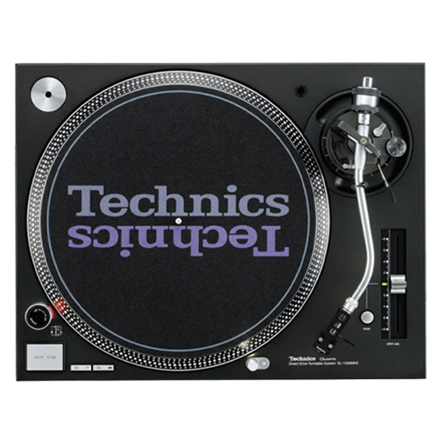
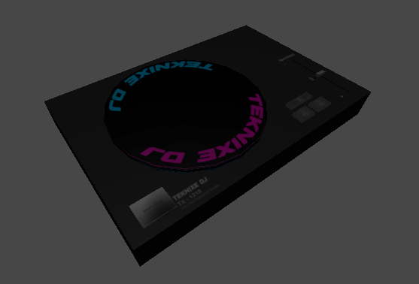
Future plans & schedule
Considering the complexity of emulating the proprietary operating system of Pioneer CDJ’s, it has been decided that alternatively a Direct-Drive Technics 1210 turntable will be implemented. The Technics 1210 is an analog device, and thus emulating it is much easier and more likely to appear realistic. This change in hardware has already been reflected in the game prototype.
Fig. 1: Technics SL1210
Fig. 2: early prototype in-game emulation of the turntable.
Fig. 1
Fig. 2

Slide 11
References

Slide 12
-Project Title Page including Student and Supervisor name
- Game overview including aims and objectivesLinks to an external site., synopsis of the game ~ 1 slide
- Game Aesthetic, (you could make use of generative AI to render a first impression) ~ 1 slides
- Main Game Mechanic, ~ 1 slide
- Narrative (if applicable) ~ 1 slide
- Requirements (features) and MOSCOW prioritisation of specific requirements ~ 2 slides
- Technology: Game Engine, such as A.I. or graphics effects, available graphics resources to be used (how could it be done). It's about finding the state of the art in the genre for your game. ~ 1 slide
- Development methodology: How do you intend to progress? Agile/WaterfallLinks to an external site.? ~ 1 slide
- Ethical, Legal and Social issues and Data Security issues: PEGI Rating, copyright, ethical issue, data security. Notes Download Notes. ~ 1 slide
- Forward plan and schedule ~ 1 slide
- References ~ 1 slide (smaller font)

